Slide 1
Stationarity, Causality & Invertibility

Slide 2
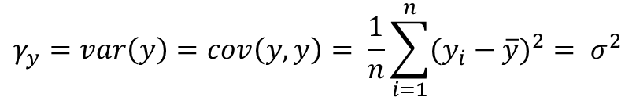
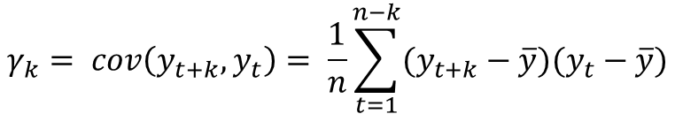
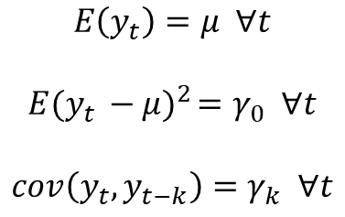
Stationarity
Strictly stationary or strongly stationary: mean & variance do not change over time
$$γ_{y}=var\left(y\right)=cov\left(y,y\right)= \frac{1}{n}\sum_{i=1}^{n}{(y_{i}−\overline{y})^{2}= σ^{2}}$$
Wide-sense or weak-sense or covariance stationary: mean & autocovariance do not change over time
$$γ_{k}= cov\left(y_{t+k},y_{t}\right)= \frac{1}{n}\sum_{t=1}^{n−k}{(y_{t+k}−\overline{y})(y_{t}−\overline{y})}$$
$$E\left(y_{t}\right)=μ ∀t$$
$$E(y_{t}{ − μ)}^{2}=γ_{0} ∀t$$
$$cov\left(y_{t},y_{t−k}\right)=γ_{k} ∀t$$
Strictly stationary
Wide-sense stationary

Slide 3
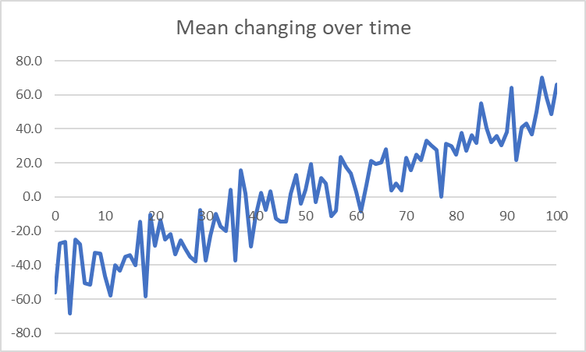
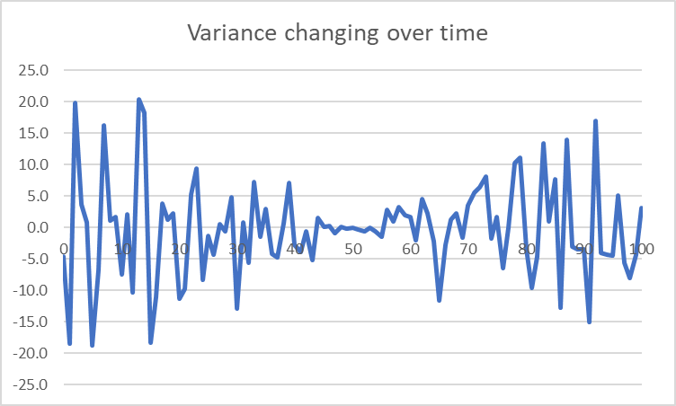
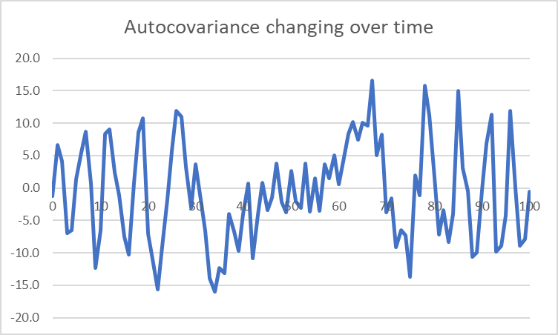
Examples of non-stationary time series
In this section we will discuss how to treat this most fundamental type of non-stationarity.
AKA: Heteroskedasticity

Slide 4
Why stationarity?
Why do we care about stationarity?
A stationary time series is simple to predict as we can assume that future statistical properties are the same as current statistical properties.
The descriptive statistics ARMA models predict (means, variances, and correlations), are only reliable if the time series is stationary. "For example, if the series is consistently increasing over time, the sample mean and variance will grow with the size of the sample, and they will always underestimate the mean and variance in future periods. And if the mean and variance of a series are not well-defined, then neither are its correlations with other variables." - http://people.duke.edu/~rnau/411diff.htm
Many real-life time series we encounter are NOT stationary. Therefore, a large part of time series analysis involves identifying if the series we want to model is stationary, and if it is not we must find ways to transform it such that it is stationary.

Slide 5
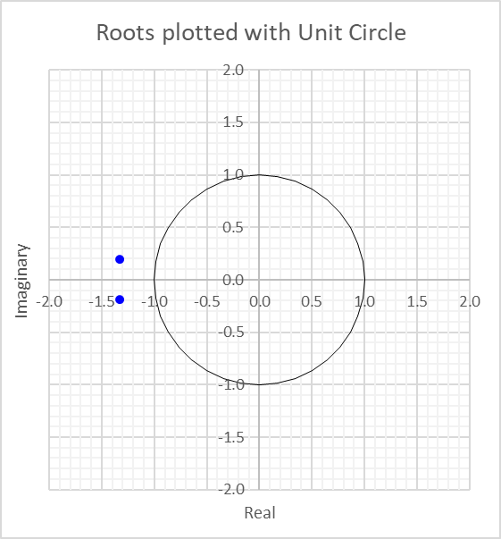
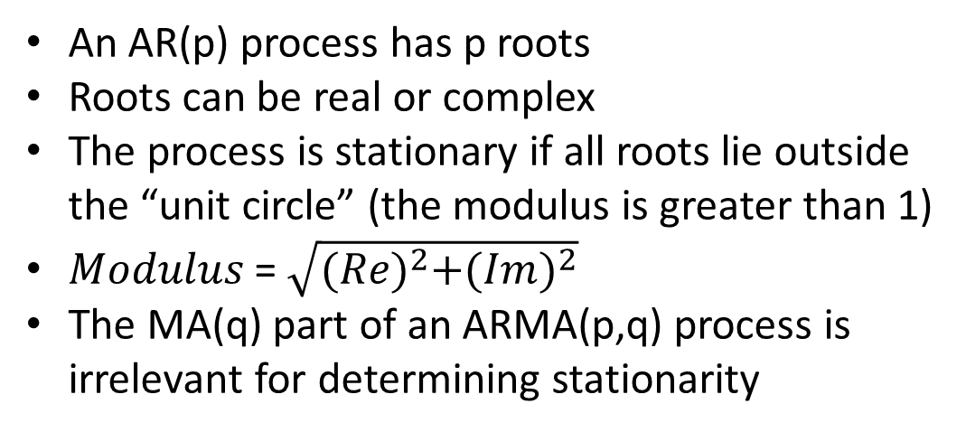
Unit Roots & Stationarity
An AR(p) process has p roots
Roots can be real or complex
The process is stationary if all roots lie outside the “unit circle” (the modulus is greater than 1)
$Modulus$ = $\sqrt{{(Re)}^{2}+{(Im)}^{2}}$
The MA(q) part of an ARMA(p,q) process is irrelevant for determining stationarity
Stationary
Stationary
Non-stationary
Stationary
Stationary

Slide 6
How to determine the characteristic roots
To find the roots of an AR equation: y_{t} = a₀ + a₁y_{t-1} + a₂y_{t-2} + … + a_{p}y_{t-p} + e_{t}
Express in terms of the lag operator: (1 - a₁L - a₂L² - … - a_{p}L^{p})y_{t} = a₀ + e_{t}
Treat the lag operator as a variable and set the resulting polynomial to zero: 1 - a₁L - a₂L² - … - a_{p}L^{p} = 0
The characteristic roots are the values of L that solve this equation.

Slide 7
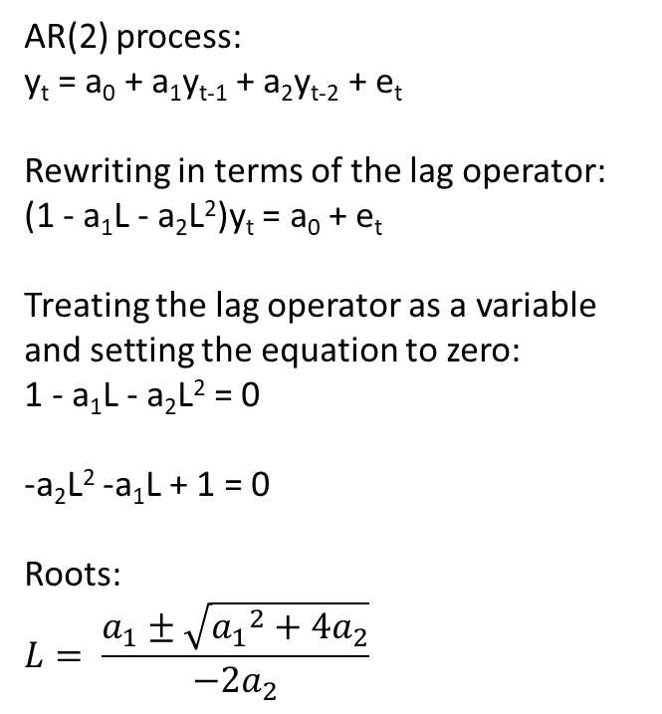
Determining characteristic roots – example
AR(1) process:
y_{t} = a₀ + a₁y_{t-1} + e_{t}
Rewriting in terms of the lag operator:
(1 - a₁L)y_{t} = a₀ + e_{t}
Treating the lag operator as a variable and setting the equation to zero:
1 - a₁L = 0
Root:
L = 1/a₁
In order for stationarity:
|L| > 1, or
|a₁| < 1 (as we already knew)
AR(2) process:
y_{t} = a₀ + a₁y_{t-1} + a₂y_{t-2} + e_{t}
Rewriting in terms of the lag operator:
(1 - a₁L - a₂L²)y_{t} = a₀ + e_{t}
Treating the lag operator as a variable and setting the equation to zero:
1 - a₁L - a₂L² = 0
-a₂L² -a₁L + 1 = 0
Roots:
$$L= \frac{a_{1}±\sqrt{{a_{1}}^{2}+4a_{2}}}{−2a_{2}}$$

Slide 8
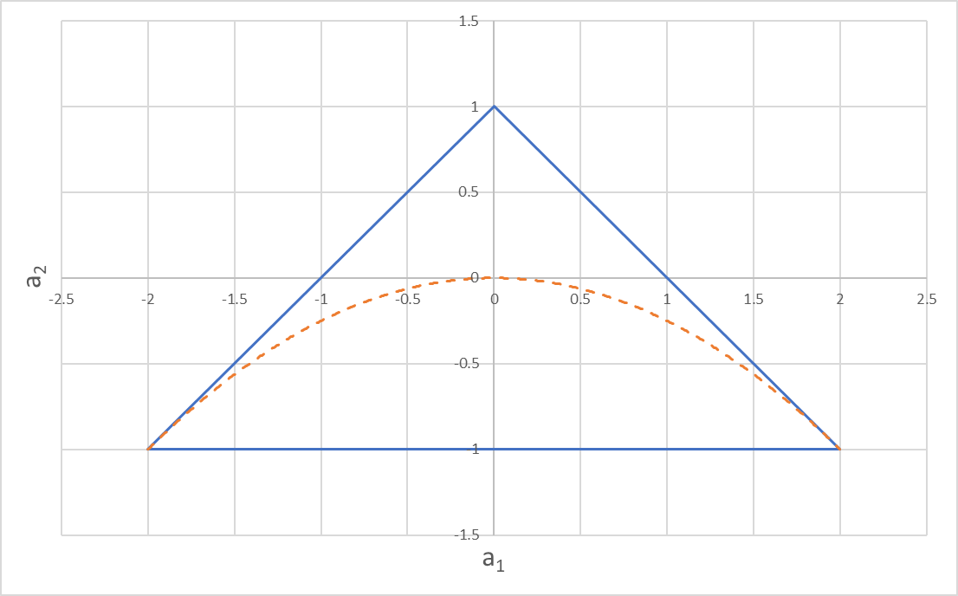
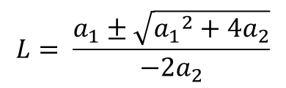
AR(2) stationary regions
$$L= \frac{a_{1}±\sqrt{{a_{1}}^{2}+4a_{2}}}{−2a_{2}}$$
Oscillatory
Non-oscillatory
Real roots
All combinations of a₁ and a₂ inside the triangle yield a stationary (non-explosive) AR(2) process.
Complex roots
Oscillatory
Oscillatory

Slide 9
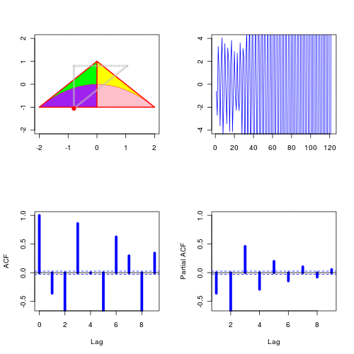
AR(2) stationary regions
https://freakonometrics.hypotheses.org/12081
gif automatically plays in slide show mode
Note how the series on the right “explodes” when the red dot travels outside the AR(2) stationary region.
Ignore the ACF and PACF for now. We will cover this in module 5.

Slide 10
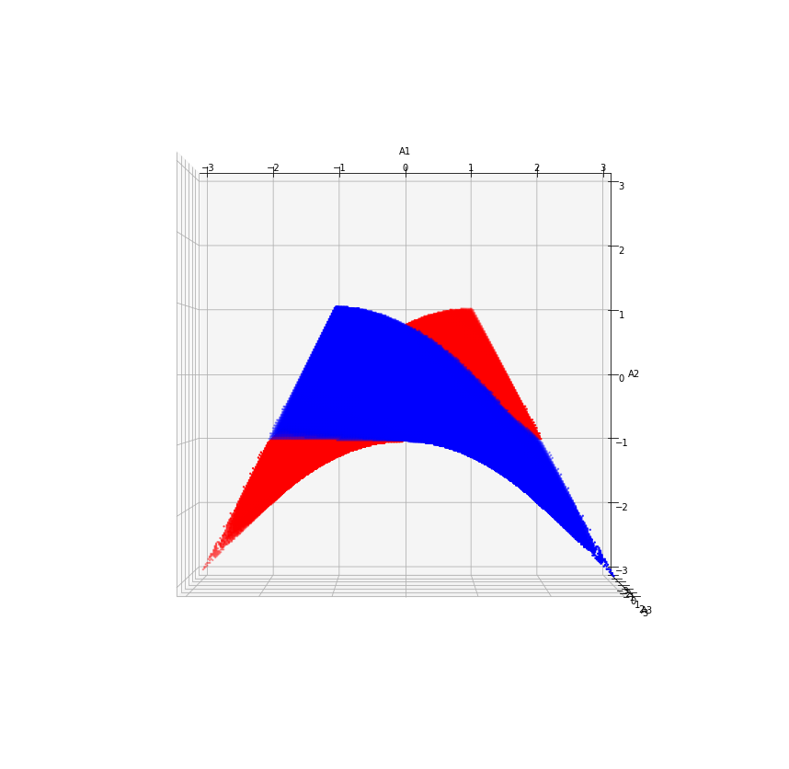
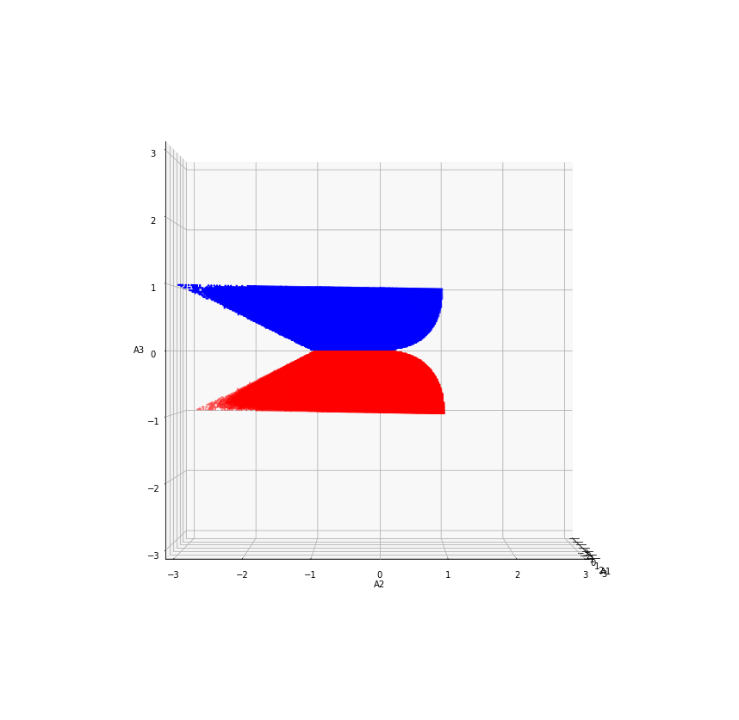
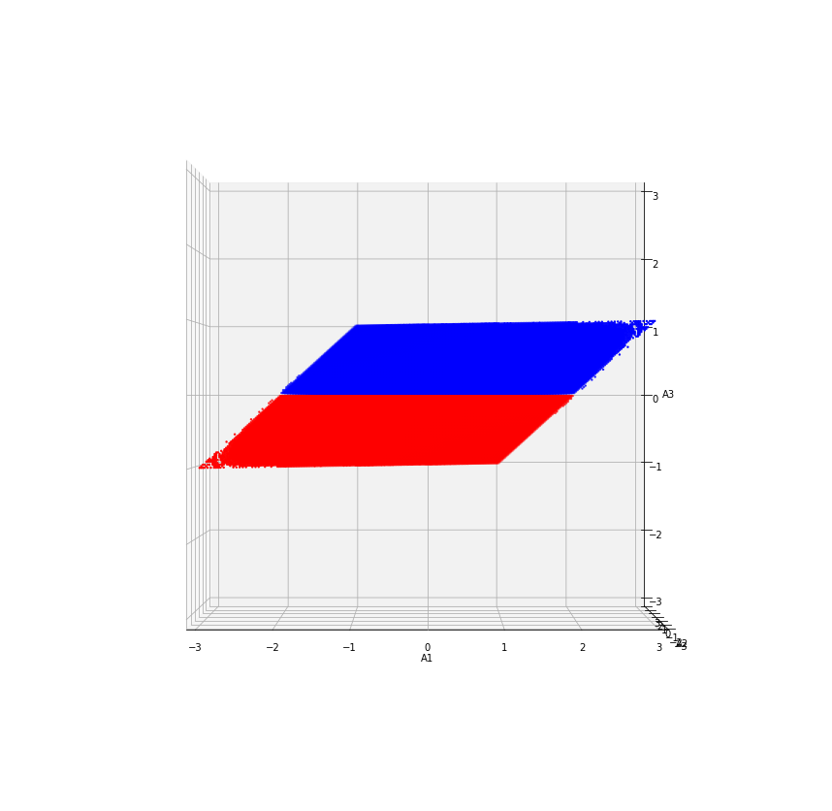
AR(3) stationary regions
AR(2) triangle (in yellow) overlaid for comparison
a2
ax.view_init(0, 0)
And rotated left
ax.view_init(90, -90)
a1
a3
Stationary regions of an AR(3) series (orthographic projection)
Color coded for clarity:
Blue = positive a3 values
Red = negative a3 values
a3
ax.view_init(0, -90)

Slide 11
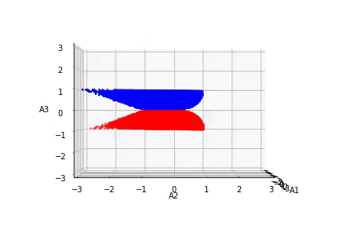
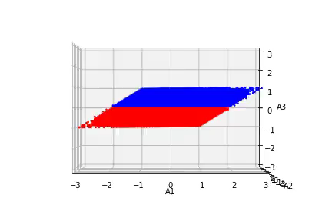
AR(3) stationary regions
Playable MP4 animations

Slide 12
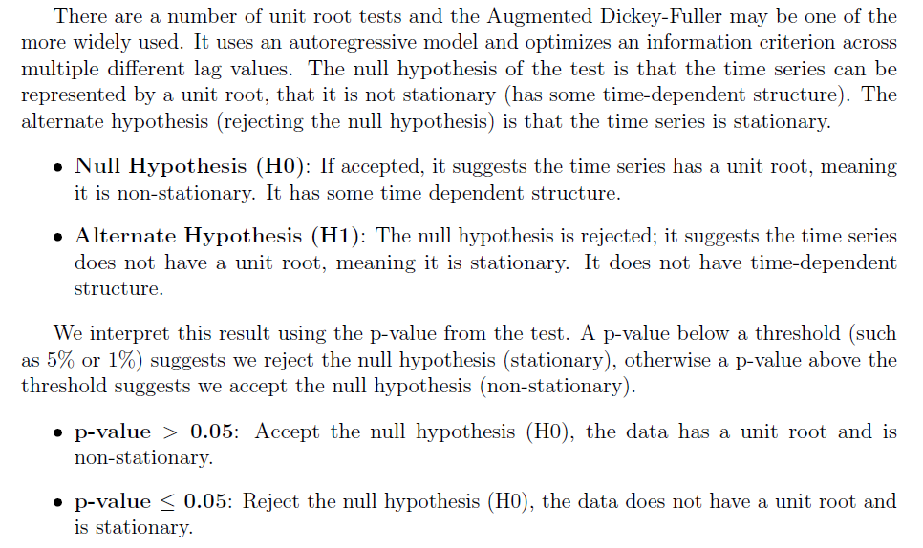
Dickey-Fuller Testing
Brownlee Ch. 15.7:

Slide 13
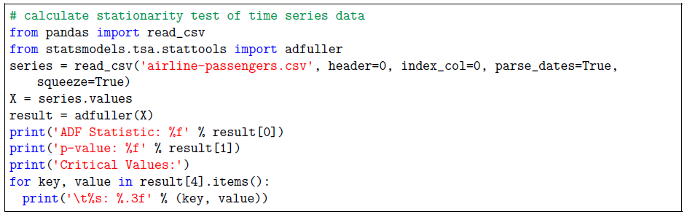
Dickey-Fuller Testing
Brownlee Ch. 15.7:

Slide 14
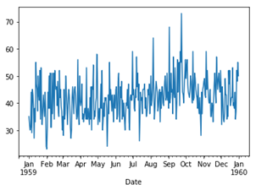
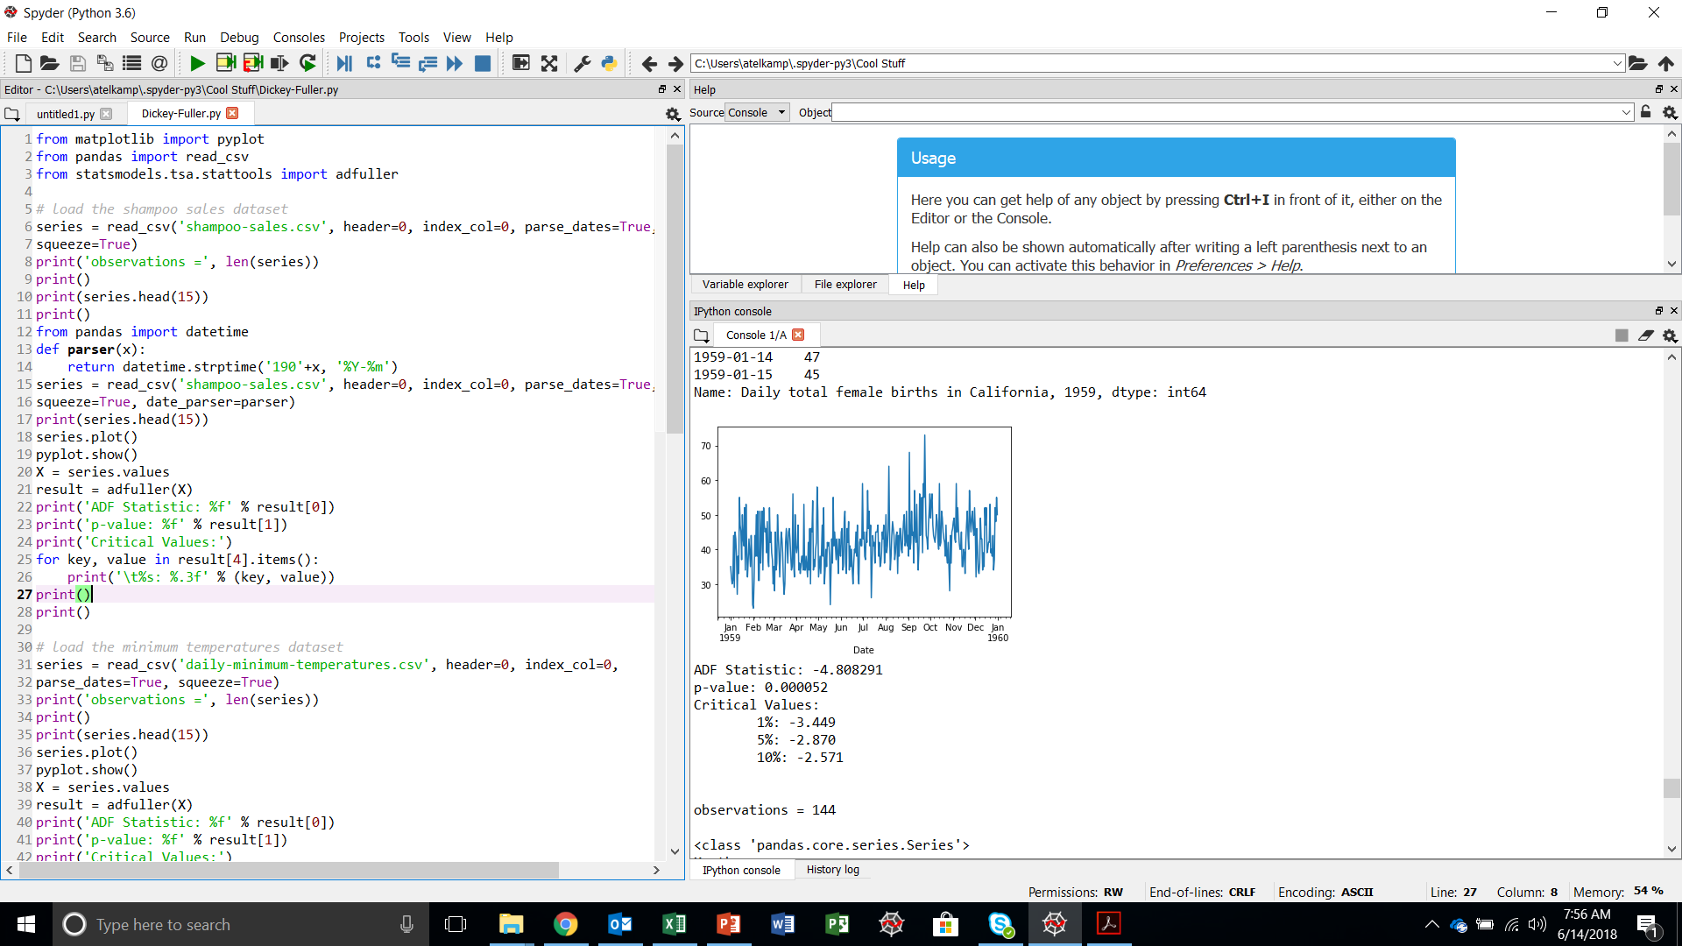
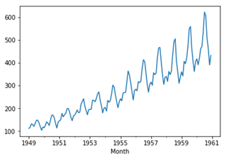
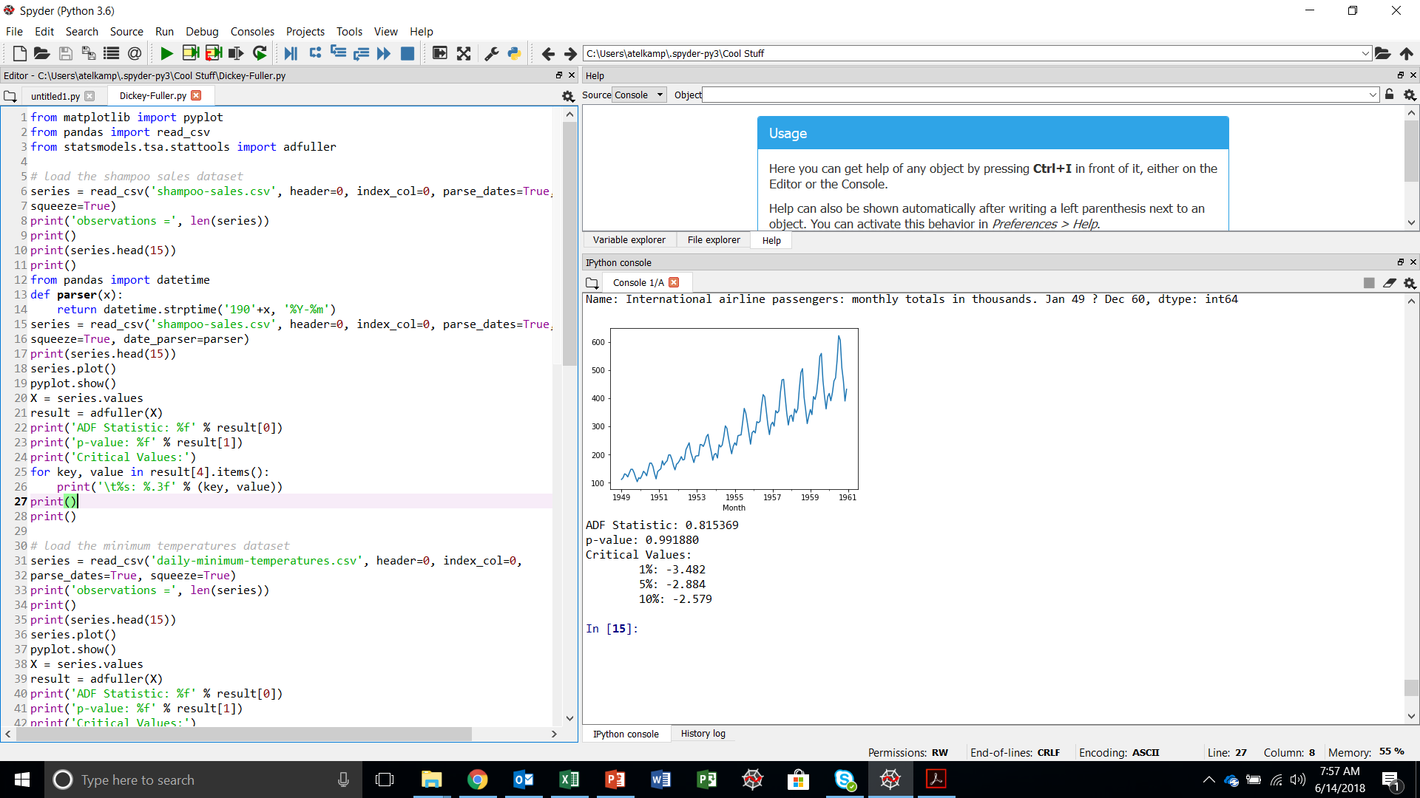
Dickey-Fuller Testing
Daily Female Births
Probability = probability of the null hypothesis (non-stationarity) prevailing
Airline Passengers

Slide 15
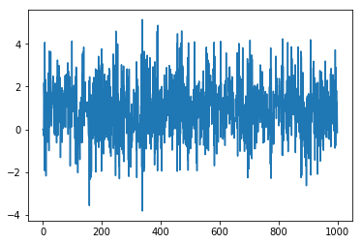
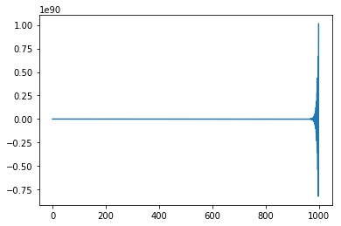
Dickey-Fuller Testing
Stationary series
Non-stationary series
Both of these series have p-values equal to zero; hence, one would assume that they are both stationary. But look closer…
ADF Statistic: -10.620031
p-value: 0.000000
Critical Values:
1%: -3.437
5%: -2.864
10%: -2.568
ADF Statistic: -100016999916648800.000000
p-value: 0.000000
Critical Values:
1%: -3.437
5%: -2.864
10%: -2.568
RuntimeWarning: divide by zero encountered in true divide
Don’t just look at the p-value!
Plot the series – does it look stationary?
Look at the ADF Statistic – is its absolute value unreasonably large (-1 x 10¹⁷)?
Large ADF Statistic values are usually accompanied by RuntimeWarnings.

Slide 16
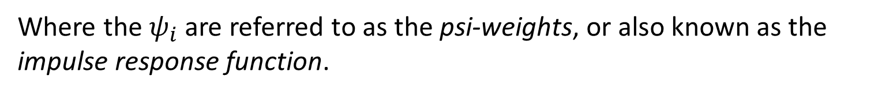
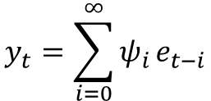
Causality
If the roots of an AR(p) process lie outside the unit circle, the process is considered “causal” and can be expressed as an infinite-term MA series.
$$y_{t}=\sum_{i=0}^{∞}{ψ_{i}}e_{t−i}$$
Where the $ψ_{i}$ are referred to as the psi-weights, or also known as the impulse response function.

Slide 17
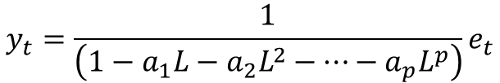
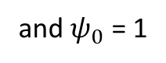
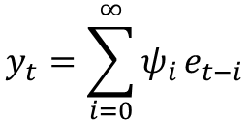
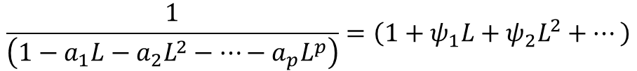
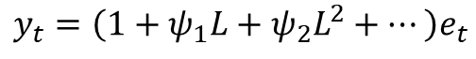
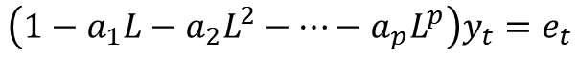
Causality
AR process
Infinite MA series
$$y_{t}=\sum_{i=0}^{∞}{ψ_{i}}e_{t−i}$$
$$\left(1−a_{1}L−a_{2}L^{2}−⋯−a_{p}L^{p}\right)y_{t}=e_{t}$$
and $ψ_{0}$ = 1
$$y_{t}=\frac{1}{\left(1−a_{1}L−a_{2}L^{2}−⋯−a_{p}L^{p}\right)}e_{t}$$
$$y_{t}=\left(1+ψ_{1}L+ψ_{2}L^{2}+⋯\right)e_{t}$$
$$\frac{1}{\left(1−a_{1}L−a_{2}L^{2}−⋯−a_{p}L^{p}\right)}=\left(1+ψ_{1}L+ψ_{2}L^{2}+⋯\right)$$
$\left(1−a_{1}L−a_{2}L^{2}−⋯−a_{p}L^{p}\right)\left(1+ψ_{1}L+ψ_{2}L^{2}+⋯\right)$ $=1$

Slide 18
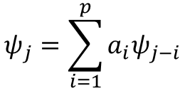
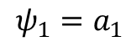
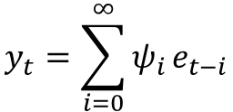
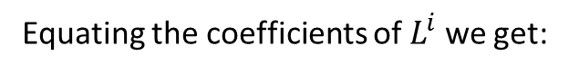
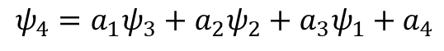
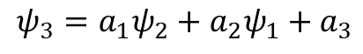
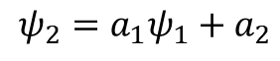
Causality
Equating the coefficients of $L^{i}$ we get:
Example: the first 12 psi-weights for an AR(2) model:
$$ψ_{1}=a_{1}$$
$$ψ_{2}=a_{1}ψ_{1}+a_{2}$$
$$ψ_{3}=a_{1}ψ_{2}+a_{2}ψ_{1}+a_{3}$$
$$ψ_{4}=a_{1}ψ_{3}+a_{2}ψ_{2}+a_{3}ψ_{1}+a_{4}$$
$$ψ_{j}=\sum_{i=1}^{p}{a_{i}ψ_{j−i}}$$
$$y_{t}=\sum_{i=0}^{∞}{ψ_{i}}e_{t−i}$$

Slide 19
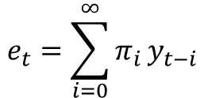
Invertibility
If the roots of an MA(q) process lie outside the unit circle, the process is considered “invertible” and can be expressed as an infinite-term AR series.
$$e_{t}=\sum_{i=0}^{∞}{π_{i}}y_{t−i}$$
Where the $π_{i}$ are referred to as the pi-weights.

Slide 20
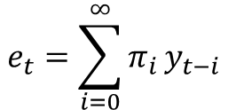
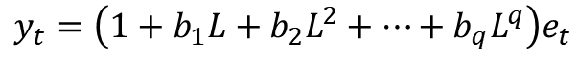
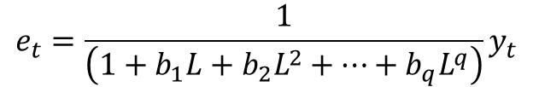
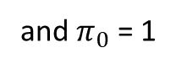
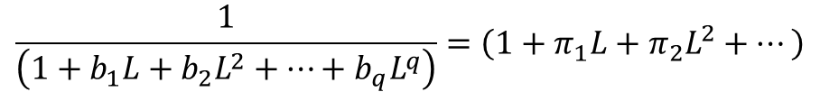
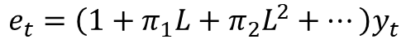
Invertibility
MA process
Infinite AR series
$$e_{t}=\sum_{i=0}^{∞}{π_{i}}y_{t−i}$$
$$y_{t}=\left(1+b_{1}L+b_{2}L^{2}+⋯+b_{q}L^{q}\right)e_{t}$$
and $π_{0}$ = 1
$$e_{t}=\frac{1}{\left(1+b_{1}L+b_{2}L^{2}+⋯+b_{q}L^{q}\right)}y_{t}$$
$$e_{t}=\left(1+π_{1}L+π_{2}L^{2}+⋯\right)y_{t}$$
$$\frac{1}{\left(1+b_{1}L+b_{2}L^{2}+⋯+b_{q}L^{q}\right)}=\left(1+π_{1}L+π_{2}L^{2}+⋯\right)$$
$$\left(1+b_{1}L+b_{2}L^{2}+⋯+b_{q}L^{q}\right)\left(1+π_{1}L+π_{2}L^{2}+⋯\right)=1$$

Slide 21
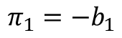
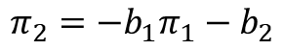
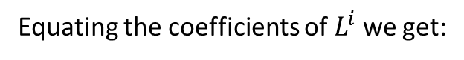


Invertibility
Equating the coefficients of $L^{i}$ we get:
$$π_{1}={−b}_{1}$$
$$π_{2}={−b}_{1}π_{1}−b_{2}$$
$$π_{3}={−b}_{1}π_{2}−b_{2}π_{1}−b_{3}$$
$$π_{4}={−b}_{1}π_{3}−b_{2}π_{2}−b_{3}π_{1}−b_{4}$$
$$π_{j}=−\sum_{i=1}^{q}{b_{i}π_{j−i}}$$

